Slide 1

IS4301 Agile IT with DevOps
Tutorial 7

Slide 2
Tutorial Objective
Set up server-side for an application
Connect the server-side to the application
Test registration and log in functions of the app
Screenshot your progress and submit a report to Luminus

Slide 3
Tools Preparation
Install
Node.js
https://nodejs.org/en/download/
Sublime text editor
https://www.sublimetext.com/
2. Download project zip archive from Luminus

Slide 4
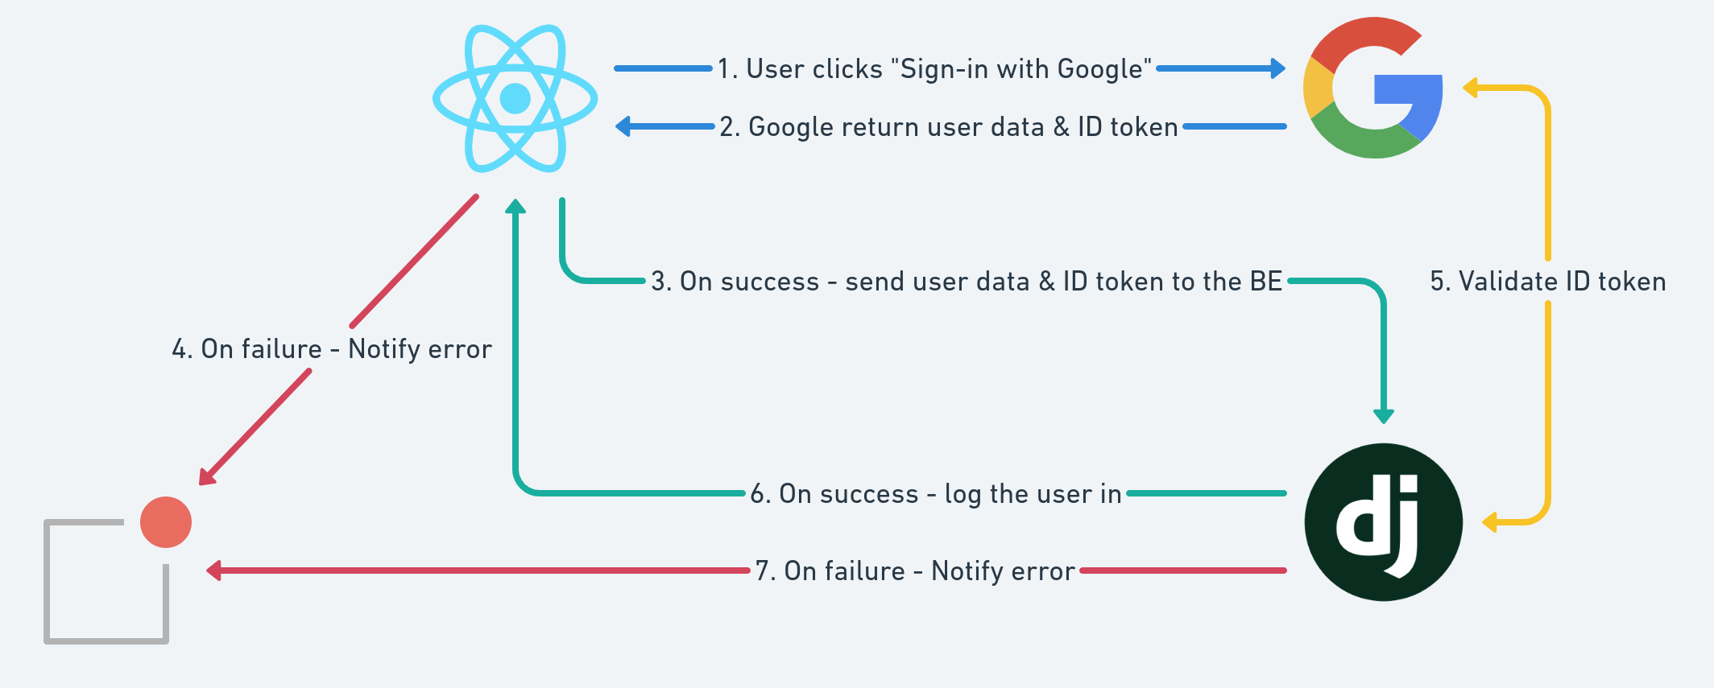
Authentication Flow: Client Side

Slide 5
Task 1: Unzip and run the application
Download the project zip archive from Luminus
Open Command Prompt/ Terminal/ Console
Navigate to the project directory
Use command “npm install” to install dependencies
Launch the project
Go to http://localhost:3000/

Slide 6
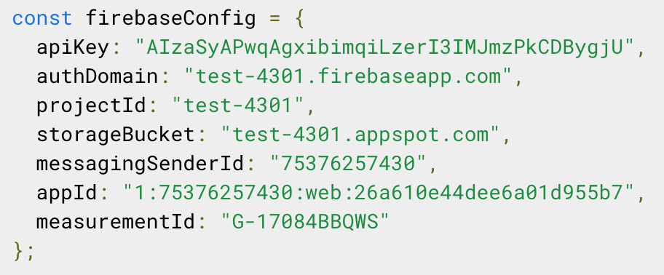
Task 2a: Create a Firebase Project
Register or log in with your google account: https://console.firebase.google.com/
Create a project
Click on the third icon (</>) to configure our Firebase project for the web
Copy the firebaseConfig constant

Slide 7
Task 2b: Configuring the application
Go to the src folder
Open firebase.js
Change the firebaseConfig constant to yours
Run the application

Slide 8
Task 3: Setting up Authentication Process in Firebase
Go to the project console
Go to the authentication tab
Click <Get Started>
Add Email/Password and Google authentication options

Slide 9
Task 4: Testing
Register with an email
Register with a google account
Login with the email
Login with the google account
Disable one of the accounts
Try logging in with it

Slide 10
Key Takeaway
Use existing services, e.g. firebase authentication and database, through APIs to save resources needed for application development
Leverage on component and service architecture to improve on scalability and agility of development process
Agile is a methodology that needs a right development environment
You cannot be agile if you are building a monolith system

Slide 11
Submit your report to Luminus

